Slide 1
Simulation in Marketing
Week 7

Slide 2
Monte Carlo Simulation
Simulation is a numerical technique for conducting experiments on a digital computer: which involves certain types of mathematical and logical models that describe the behavior of business or economic systems (or some component thereon over extended period of real time.

Slide 3
Monte Carlo Simulation
A method of estimating the value of an unknown quantity using the principles of inferential statistics
Inferential statistics
Population: all possible scenarios
Sample: a proper subset of a population
Key fact: a random sample tends to exhibit the same properties as the population from which it is drawn
If we choose the sample at random, the sample tends to represent the populations
MIT Lecture Notes

Slide 4
Monte Carlo Simulation: Example
Flipping coins
Suppose I flip it once and it shows head, would you think the next one is head?
What is a flip it twice and it is head, would you think the next one is head?
How about a hundred times and it is head?
Maybe you should assume the next one is head.
What if it was mixed between heads and tails?
Would you be able to predict?
Variance is the key word here!
Notes:
The answer is not very likely
Yes based on the ration of heads to tails 52 heads and 48 tails in 100 flips
Why good guess for 100 heads and not the second

Slide 5
Motivation
No matter how smart you are, there will always be probabilistic problems that are too hard to solve analytically.
Despite (1), if you know a good scientific programming language that incorporates a random number generator, you may still be able to get numerical answers to those “too hard” problems.

Slide 6
Advantages
Full valuation: no problems with non linear or non monotonic variables
Flexibility: possibility to use any probability distribution functional form

Slide 7
Fair Roulette Example

Slide 8
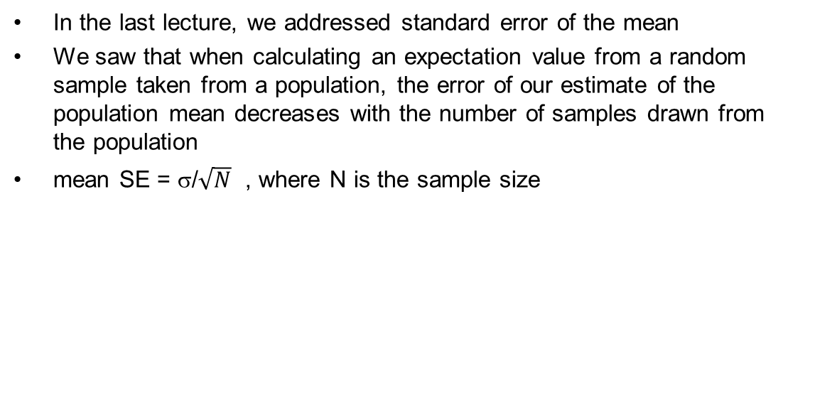
Convergence Properties of Monte Carlo Simulation
The larger the sample size from a population, the smaller the error of the mean estimate
The larger the standard deviation of the population distribution, the more samples are required to reduce the error of the mean estimate
The same principle applies to Monte Carlo simulation
Notes:
is the standard deviation of its sampling distribution or an estimate of that standard deviation of estimate. If the parameter or the statistic is the mean, it is called the standard error of the mean (SEM).

Slide 9
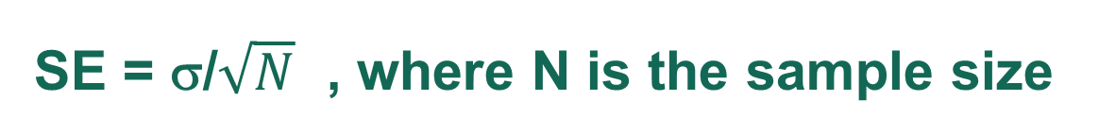
In Monte Carlo simulation, instead of sampling from a population that exists in the world, we are sampling from a population described by a probability distribution that we use to model our random variables.
In other words we “simulate” a population using a known probability distribution, based on our assumptions
This “known” probability distribution may be empirical in nature, in other words it is not usually based on a formula that we can easily use to calculate our expectation values by hand. For example, we can sample customer behavior from an empirically observed histogram of customer behavior outcomes, such as purchase decisions after exposure to different marketing techniques
We need to simulate taking a sample from a population described by the probability distribution. The number of times we sample from the distribution is the sample size.

Slide 10
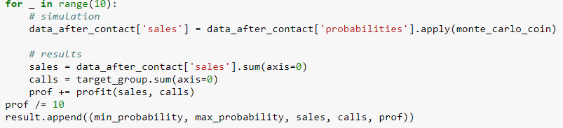
Monte Carlo simulation
Many samples
Average of outcome over many samples
The sampling is usually accomplished using a loop control structure,
The number of times the loop is executed is the simulated sample size. In the example above, the sample size is 10.
The outcome we are simulating is profit, so the average profit is equal
to the profit we calculated for each of the 10 population samples, divided by 10.
This is the heart of Monte Carlo simulation.

Slide 11
Monte Carlo simulation
Many samples
Of many simultaneous
Binomial variables
Average of outcome over many samples
In our example, we simulate taking samples from a population of
customers and we have described their behavior with a probability
distribution that is a set of simultaneous binomial variables. The
parameters for each binomial variable are listed in the “probabilities”
field of the data frame “data after contact”. This is our “known” probability
distribution. In the case of binomial variables, there is only one parameter
for each binomial variable, probability of success. However,
this assumed distribution can be replaced in the model with any other
probability distribution.

Slide 12
Monte Carlo simulation
The simulation is executed by sampling from this probability distribution using a random
number generator.
The Pandas method “apply”, used in this example, applies the function, Monte Carlo coin taken in as an argument to the column of values it is associated with by taking the column values as arguments to the function. More information may be found in the documentation.
In this example, the function Monte Carlo coin is used to simulate the 10 samples from the population described by the known probability distribution described by the parameters in the ‘probabilities’ column of the “data after contact”.

Slide 13
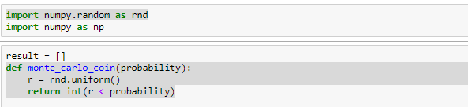
Random Number Generation
The numpy random package has several random number generator functions that can be used to simulate samples from a population with the given distribution. These include gaussian and uniform random number generators, which are the most common. Random number generators are deterministic sequences that have been specifically designed to appear random. They are often called “pseudo” random numbers for this reason. The sequence begins with a seed value from which subsequent values in the random sequence are derived. In Python the seed is usually set using the “random state” keyword argument. To ensure that the same random number sequence is executed each time an algorithm is used, the seed value can be set as part of the program execution. Different seed values generate different pseudo random sequences. In this course, we may consider these pseudo random sequences to be equivalent to the random sequences of interest. It is typically only necessary to consider deviations from truly random sequences if higher order moments of a distribution are pertinent to a simulation.

Slide 14
Next: Open marketing simulation in Jupyter Notebook
Find the Jupyter Notebook link in the Anaconda folder
Click on it
This should open a window in your browser
Open the file “Marketing_Campaign_Simulation”
We will review the file together and then repeat the exercise for a slightly altered scenario involving fixed and variable costs for the laboratory portion of the class

